Slide 1

Better Together: Text + Context
https://kwchurch.github.io/
Kenneth Church
Sept 2023

Slide 2
Challenge: Reasoning with Large Collections of Documents
Examples:
Documents that match query
Documents in field/subfield/topic/venue
Documents by certain authors
WHO: time/space/disease

Slide 3
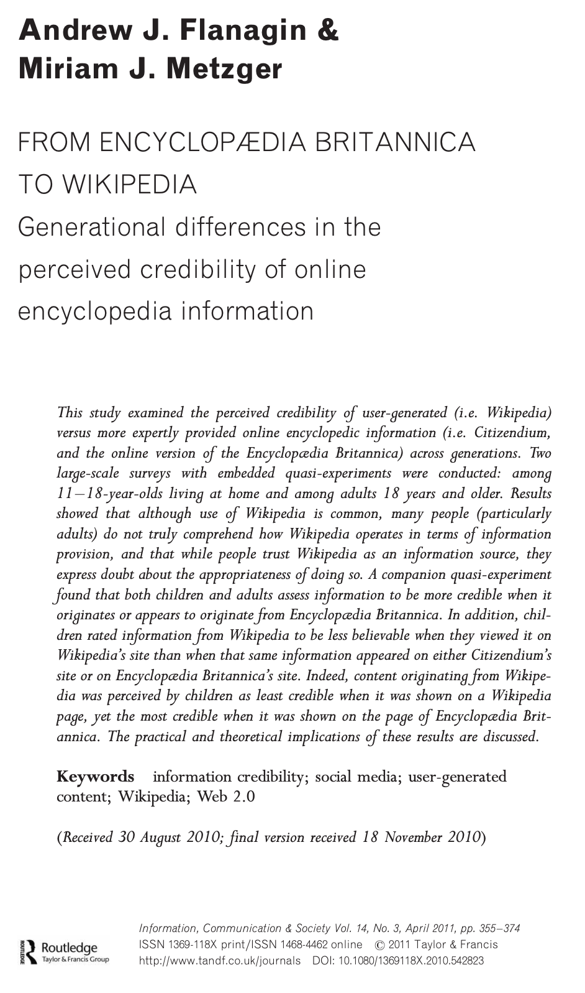
WHO/ProMed Application (Is Freeware >> Legit/Official/$$$ ?)
WHO:
Mandate to issue alerts
There are rumors that
WHO is subject to political pressure
ProMed:
Crowd-sourced alternative
Less subject to political pressure
Question(s):
Who scoops who? Credibility?
Data
WHO: 3k URLs (102/year since 1996)
ProMed: 65k URLs (2384/year since 1996)
Method:
Map contents of URLs → Vectors
Find matches with ANN (approximate nearest neighbors)

Slide 4


Challenge: Hall of Mirrors (too many matches) Jan 12: Reuters Jan 13: ProMED Jan 14: WHO
https://promedmail.org/promed-post/?id=20090113.0142
https://www.who.int/emergencies/disease-outbreak-news/item/2009_01_14a-en

Slide 5
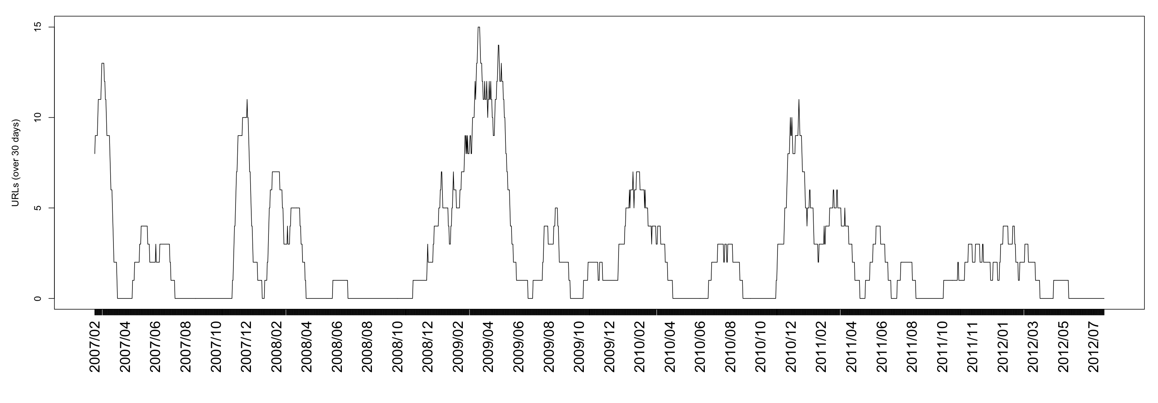
URLs about Egypt & Avian Flu
Date of WHO URL | Days since prev report
January 14, 2009 | 29
January 26, 2009 | 12
February 5, 2009 | 10
February 9, 2009 | 4
March 2, 2009 | 21
March 10, 2009 | 8
March 11, 2009 | 1
March 23, 2009 | 12
March 30, 2009 | 7
April 8, 2009 | 9
April 17, 2009 | 9
April 21, 2009 | 4
April 23, 2009 | 2
May 6, 2009 | 13
May 15, 2009 | 9
May 22, 2009 | 7
May 28, 2009 | 6
June 2, 2009 | 5
July 1, 2009 | 29
August 11, 2009 | 41
August 31, 2009 | 20
September 24, 2009 | 24
November 20, 2009 | 57
November 27, 2009 | 7
December 21, 2009 | 24
January 28, 2010 | 38
Jan 12: Reuters Jan 13: ProMED Jan 14: WHO
ProMED
19% of 2009 WHO reports mention “Egypt” & “Avian”

Slide 6
WHO / ProMED (Preliminary) Results
ProMED has more resolution
23x More reports (2384/year vs. 102/year)
More content per report
More citations to sources
If less is more
then WHO is brief and to the point
Alternative hypothesis:
More is more (but useful to summarize with timelines)
Challenge for Information Retrieval/Summarization: find the bigger picture
Failure to find (so far)
Not prepared to say that WHO is late because of politics

Slide 7
Recommendation: More than Word Overlap
Recommendations
What should I read?
What should I cite?
Many systems focus on ``relevance’’ (word overlap)
But we also want credibility
Don’t recommend papers that are buzz-word compliant
But not worth reading
(Most papers are never cited)

Slide 8
Agenda (for Final Presentation on YouTube) https://kwchurch.github.io/
1.5 hours
1.5 hours
Intro (Ken) – 20 min
Centroids/Related Work
(Rodolfo) – 15 min
Bins
(Shabnam) – 15 min
Forecasting over time
Losses + Time & Space
Production Runs
(Ben) – 10 min
Time & Space
Break – 30 minutes
Experiments
Perplexity (Abteen) – 20 min
Random Walks (Peter) – 10 min
Local Citation Prediction (Peter) – 10 min
Time prediction (Melissa) – 15 min
GNNs (Sandeep, Hui) – 15 min
Deliverables/Conclusions
(Ken) – 5 minutes
Questions – 15 min
https://github.com/kwchurch/JSALT_Better_Together

Slide 9
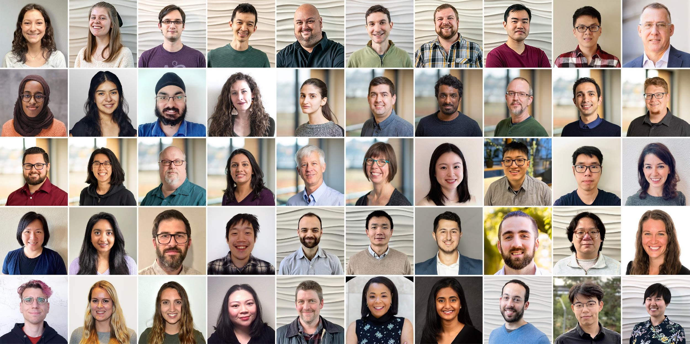
Semantic Scholar (S2): Significant Effort (slide from Dan Weld)
50 person team
7 year project
207M+ scientific paper index
8M+ monthly active users

Slide 10
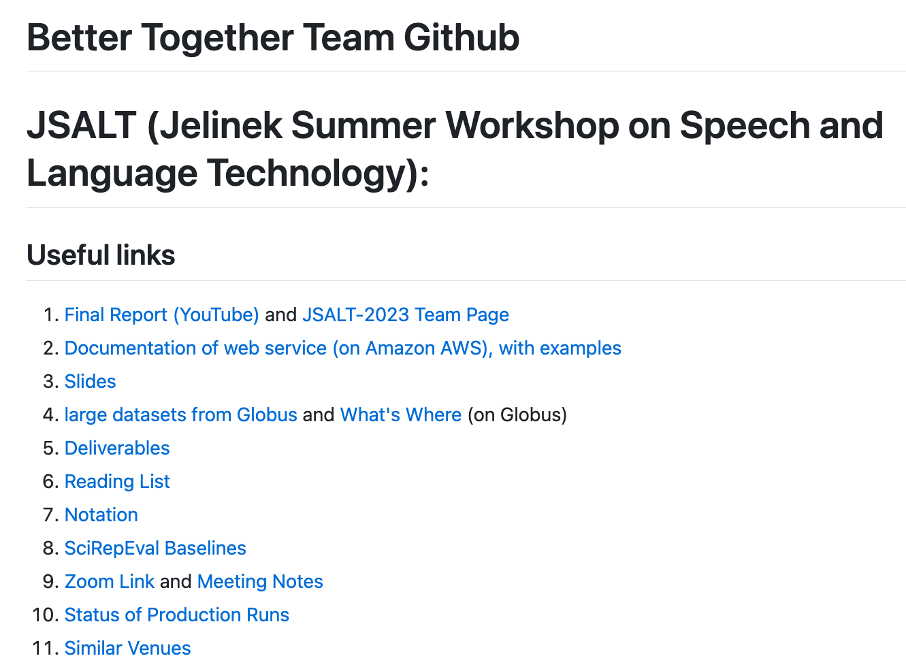
https://github.com/kwchurch/JSALT_Better_Together
YouTube
Web Page
including these slides

Slide 11
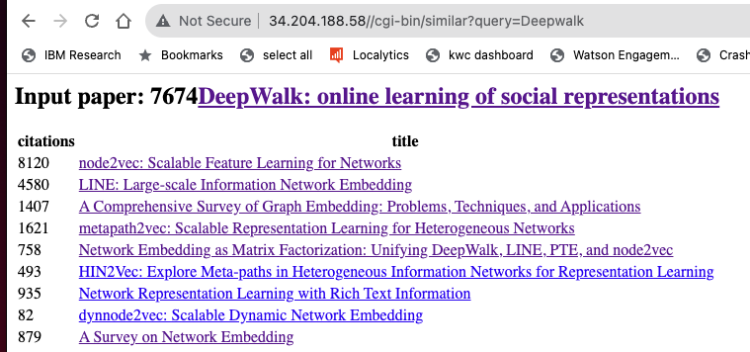
https://www.semanticscholar.org/product/api/gallery

Slide 12
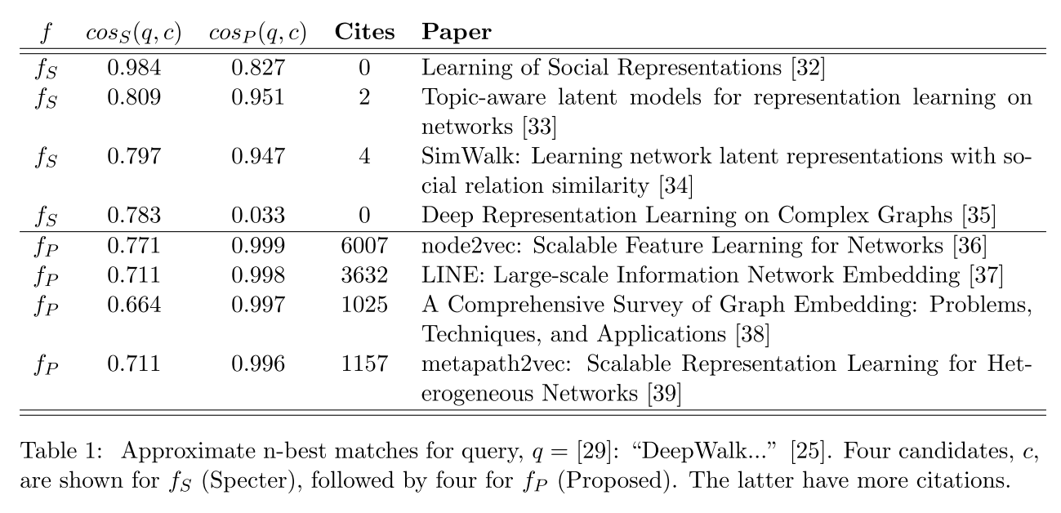
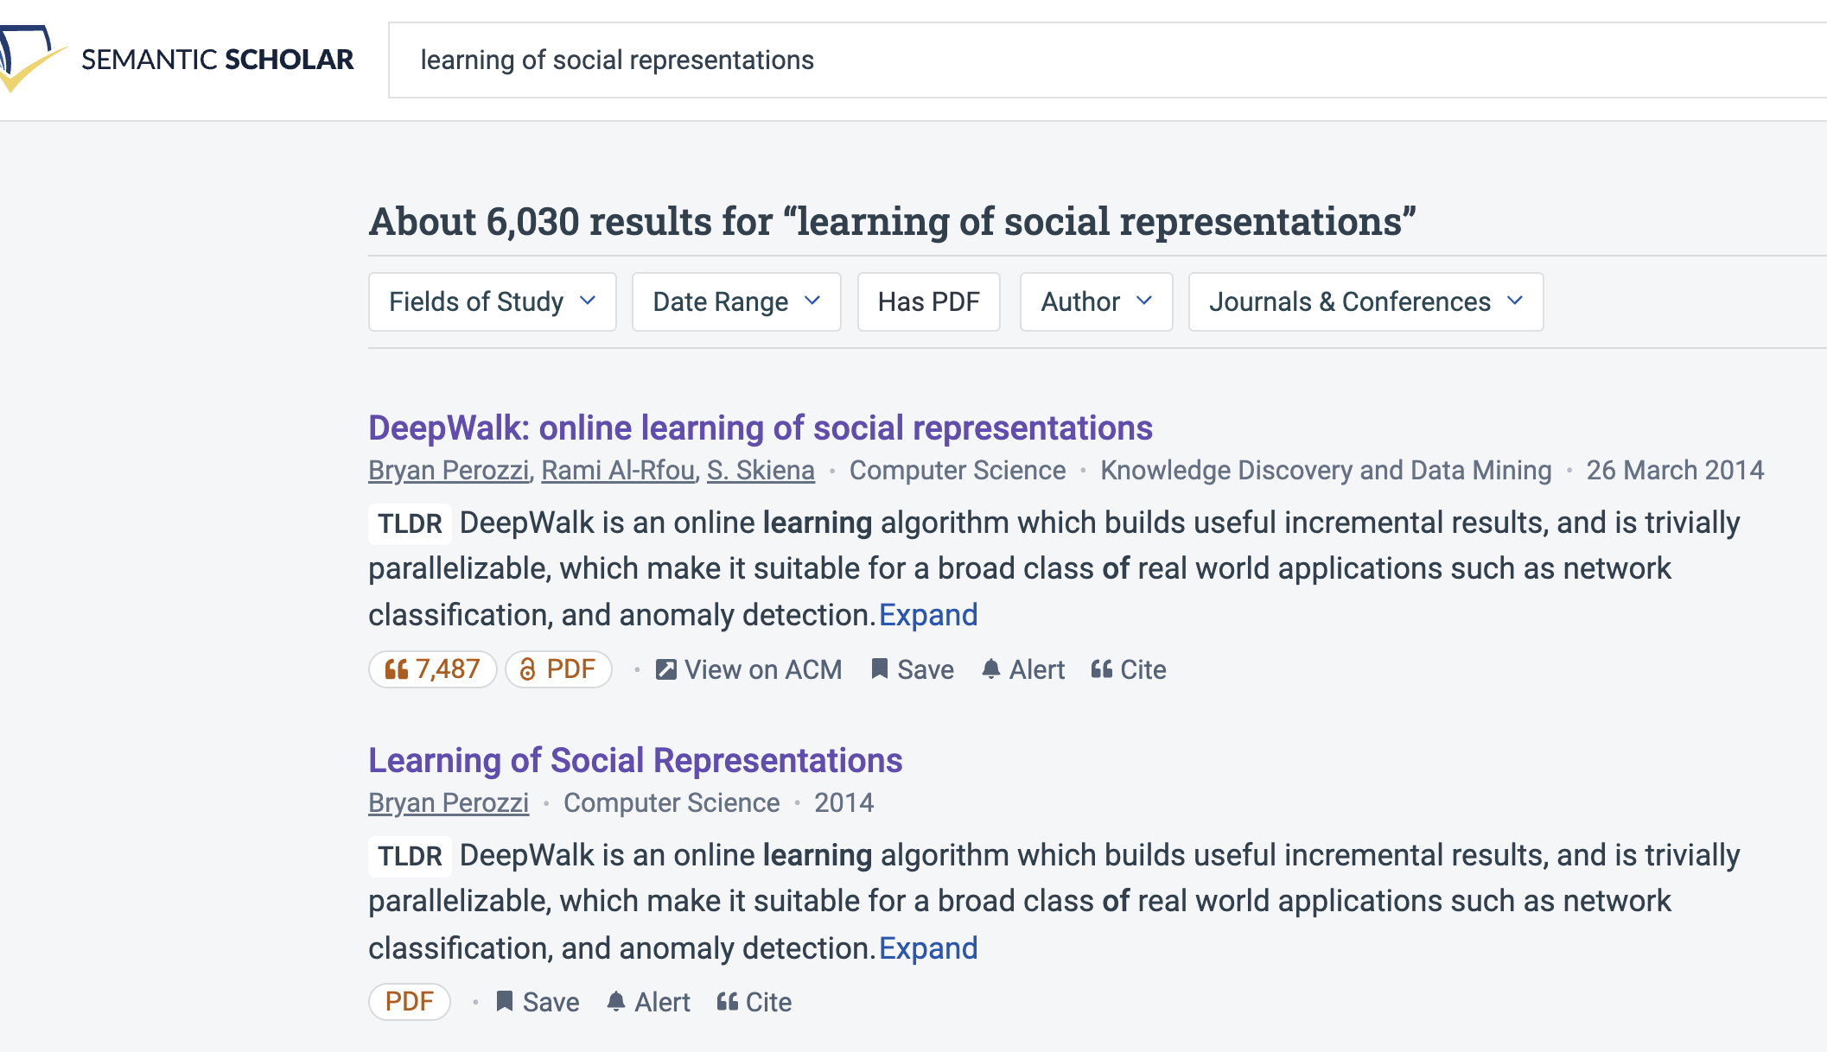
Query: ``DeepWalk: Online Learning of…’’

Slide 13
Recommendation: More than Word Overlap
Recommendations
What should I read?
What should I cite?
Many systems focus on ``relevance’’ (word overlap)
Better Together:
Text (word overlap) +
Context (citations)
Dups:
Not Good

Slide 14
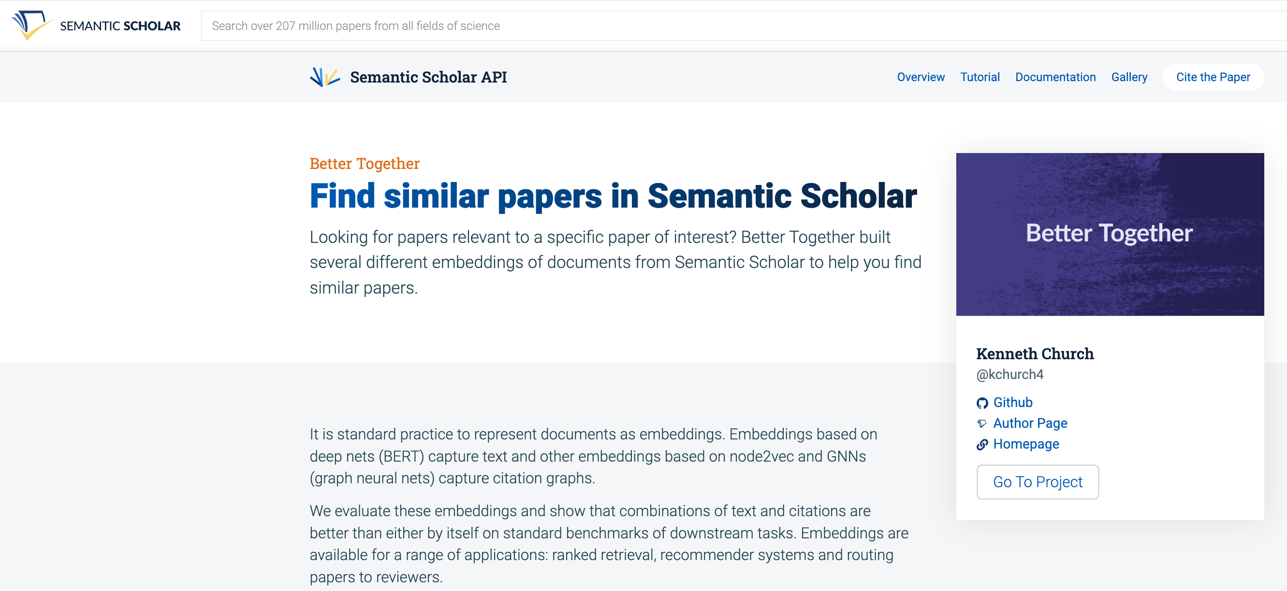
https://www.semanticscholar.org/product/api/gallery
click here

Slide 15

<return>

Slide 16
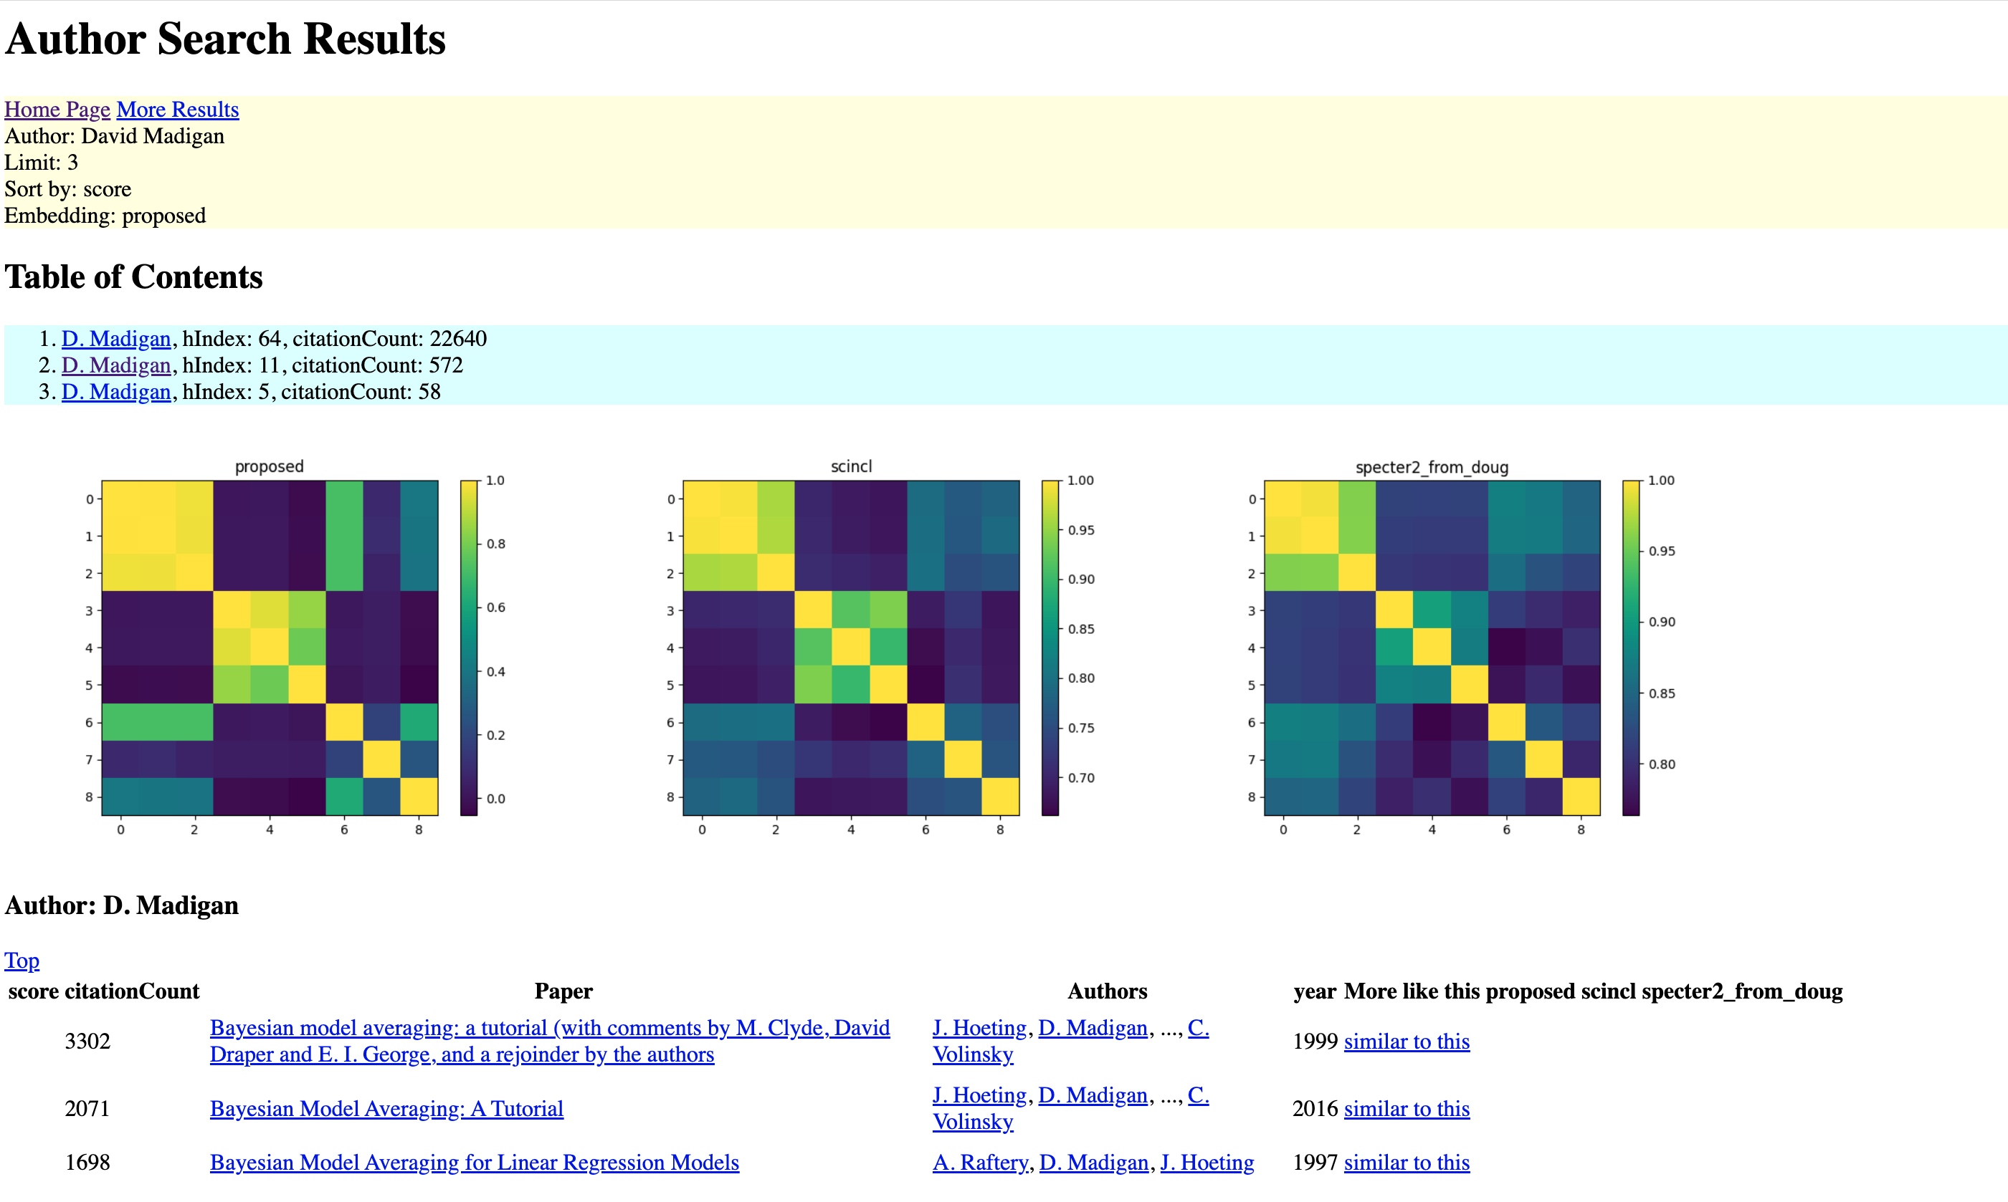
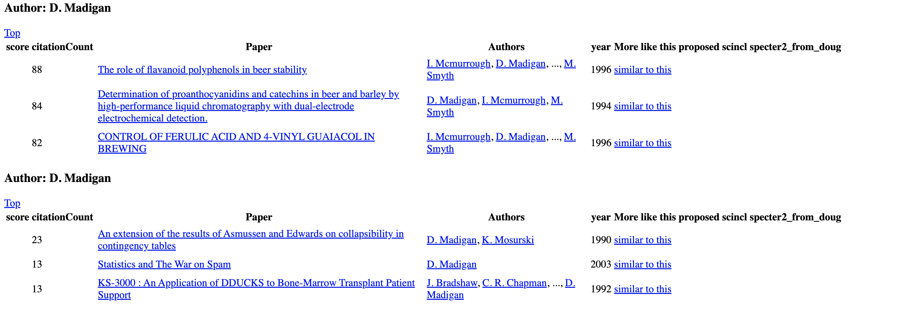
https://www.semanticscholar.org/api-gallery/better-together

Slide 17
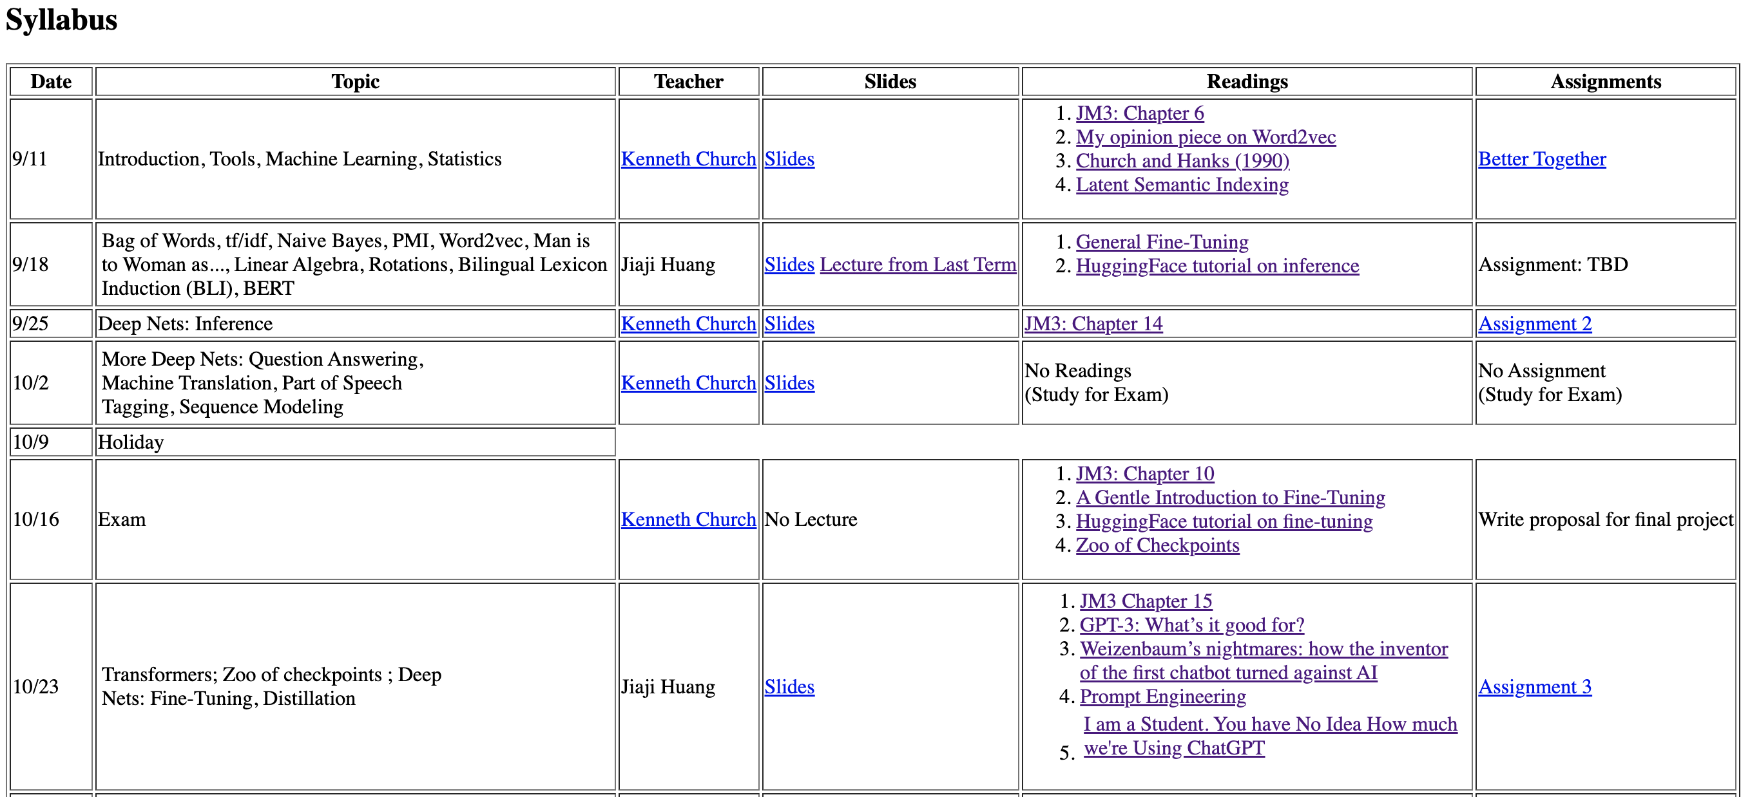
CS6120: Practical Natural Language Processing https://kwchurch.github.io/

Slide 18

Better Together: Text (Titles, Abstracts, Body); Context (Citations)
Specter, SciNCL
ProNE

Slide 19


Deliverables
GitHub:
massive (but needs editing)
slides, code, reading list
pointers to large files on Globus
Web Server
Recommendations
Input: queries (docs)
Output: recommendations (docs)
What Should I read? Cite?
Resources
Data behind web server:
citation graph
embeddings
indexes for approx. nearest neighbors
pairs of corpusIds with large cosines
all of the above for
Specter1, Specter2, SciNCL, ProNE
x100 bins for ProNE
Evaluations & Benchmarks
Intrinsic: Perplexity, Random Walks
Extrinsic: Local Citation Prediction

Slide 20
Opportunity: More Realistic Benchmarks
The Real World
Idealizations (Standard Benchmarks)
Large (Metcalfe’s Law)
Growing
Dirty
Missing Values
Bad/misleading Values
Small
Static
Clean

Slide 21
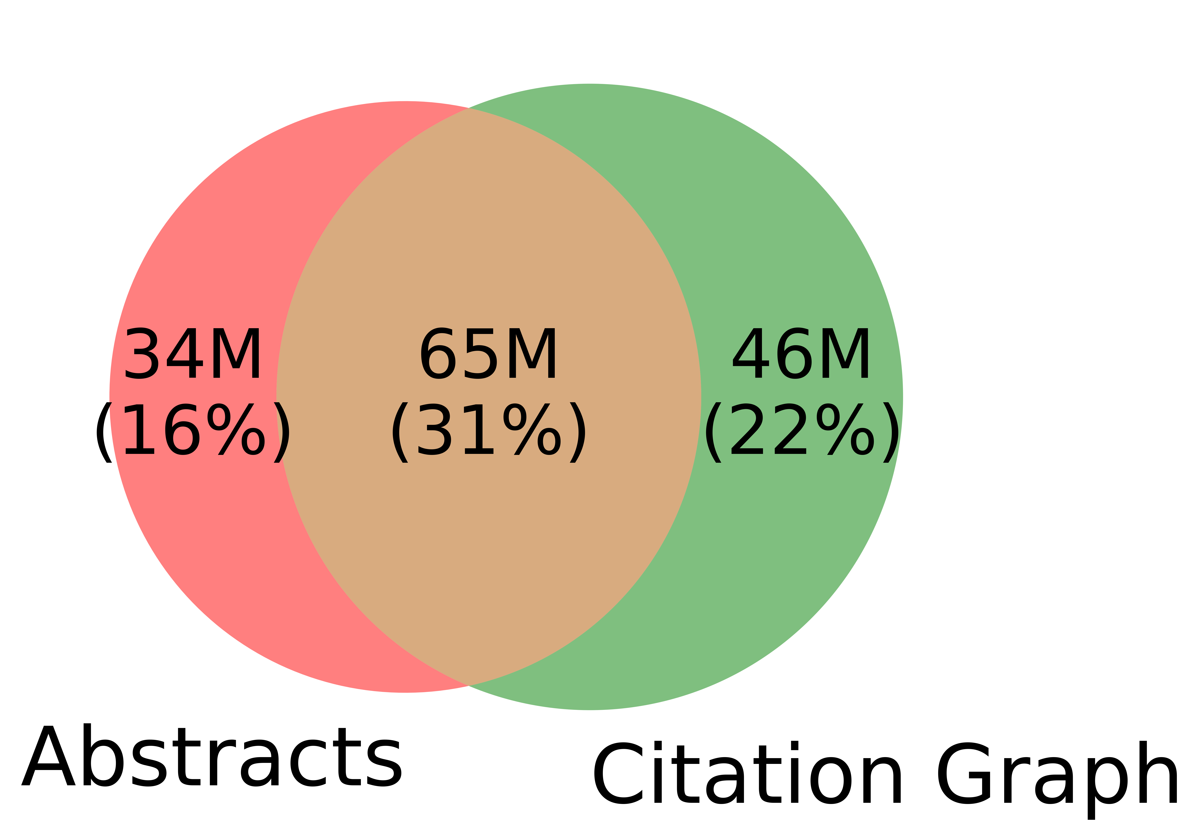
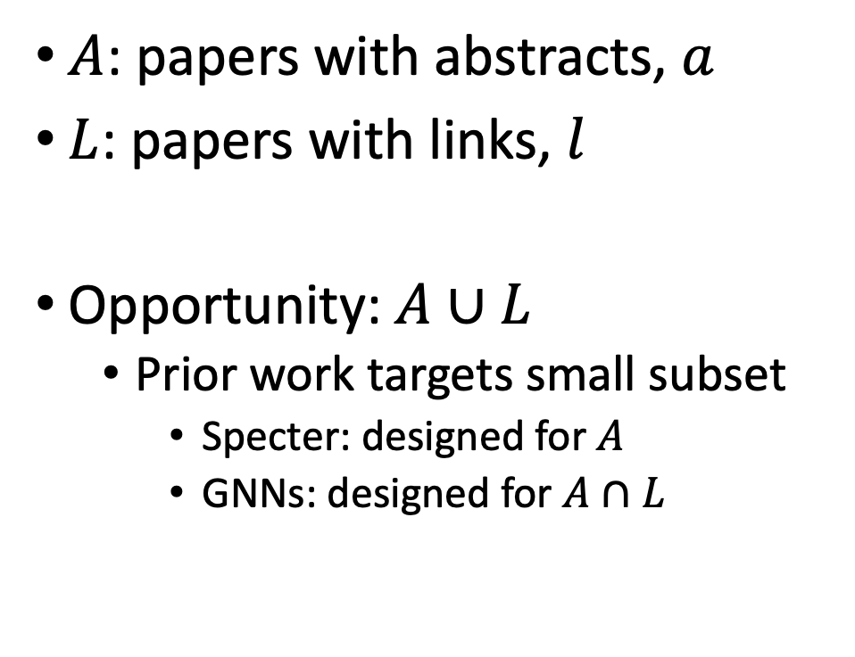
Realities (Dirty): Missing Values
$A$: papers with abstracts, $a$
$L$: papers with links, $l$
Opportunity:$A∪L$
Prior work targets small subset
Specter: designed for $A$
GNNs: designed for $A∩L$
Other
31%

Slide 22


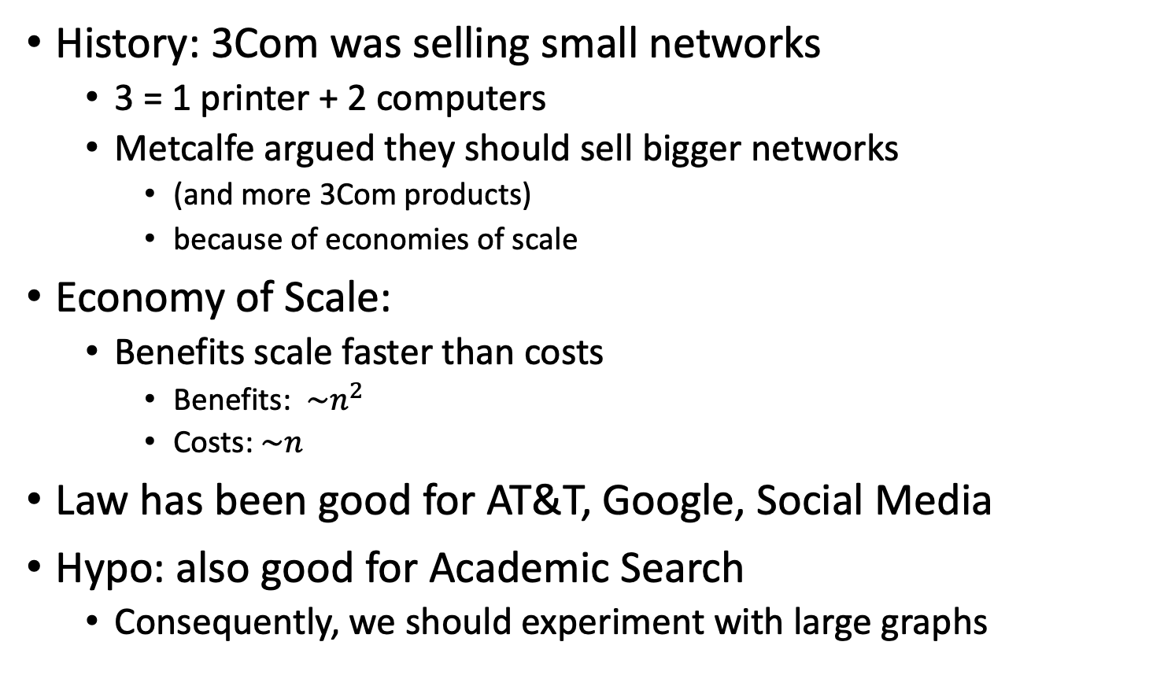
Metcalfe’s Law (Network Effects)
History: 3Com was selling small networks
3 = 1 printer + 2 computers
Metcalfe argued they should sell bigger networks
(and more 3Com products)
because of economies of scale
Economy of Scale:
Benefits scale faster than costs
Benefits: $\sim n^{2}$
Costs:$\sim n$
Law has been good for AT&T, Google, Social Media
Hypo: also good for Academic Search
Consequently, we should experiment with large graphs

Slide 23
Better-Together Conjectures
Multiple representations are helpful
for missing values (and bad values)
If abstracts are missing, use links
If links are missing, use abstracts
and for graphs of different sizes
When graphs are small:
Text >> Links
when graphs are large:
Links >> Text (Metcalfe’s Law)

Slide 24
Opportunities
Scale
Prediction
Many benchmarks return a single number (figure of merit)
How does performance scale
with the size of the problem?
Standard test/train splits
More relevant to interpolation
than extrapolation
Time is asymmetric
It is difficult to make predictions
especially about the future
-- Yogi Berra

Slide 25
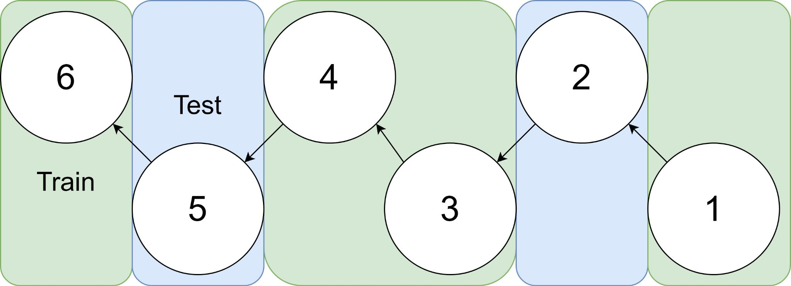
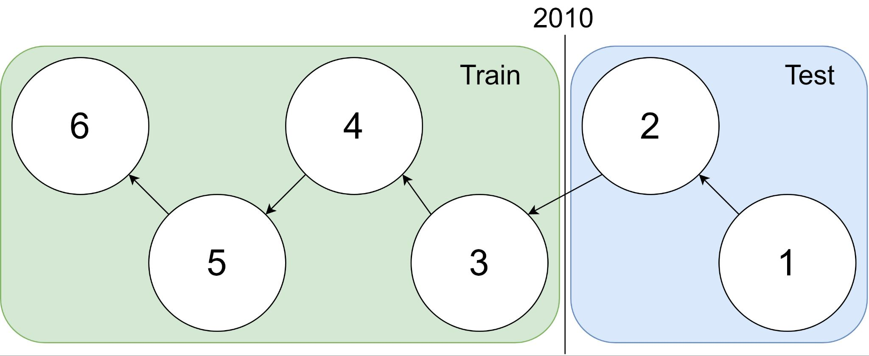
Example: 1 cites 2, 2 cites 3, … 5 cites 6
Traditional Train-Test Split (Non-Causal)
idx | Pub Year | Paper Title
1 | 2018 | [...] Photofragment imaging
2 | 2016 | Convenient probe of S(1D2)[...]
3 | 2005 | Megapixel ion imaging [...]
4 | 2003 | Direct current slice imaging [...]
5 | 1995 | profiles of Cl(2Pj) photofragments [...]
6 | 1988 | Adiabatic dissociation of [...]
Proposed Train-Test Splits (Causal)
Notes:
No asymmetry of time - how to reduce to a soundbite
Audience soundbites
‘Almost all studies in ml do test-train split’ that’s a bad idea when you have time

Slide 26
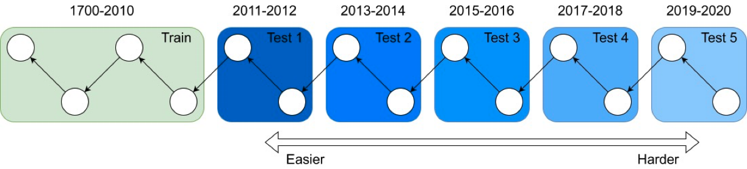
It's tough to make predictions, especially about the future ― Yogi Berra
Forecasting: short-term predictions are easier than long-term

Slide 27
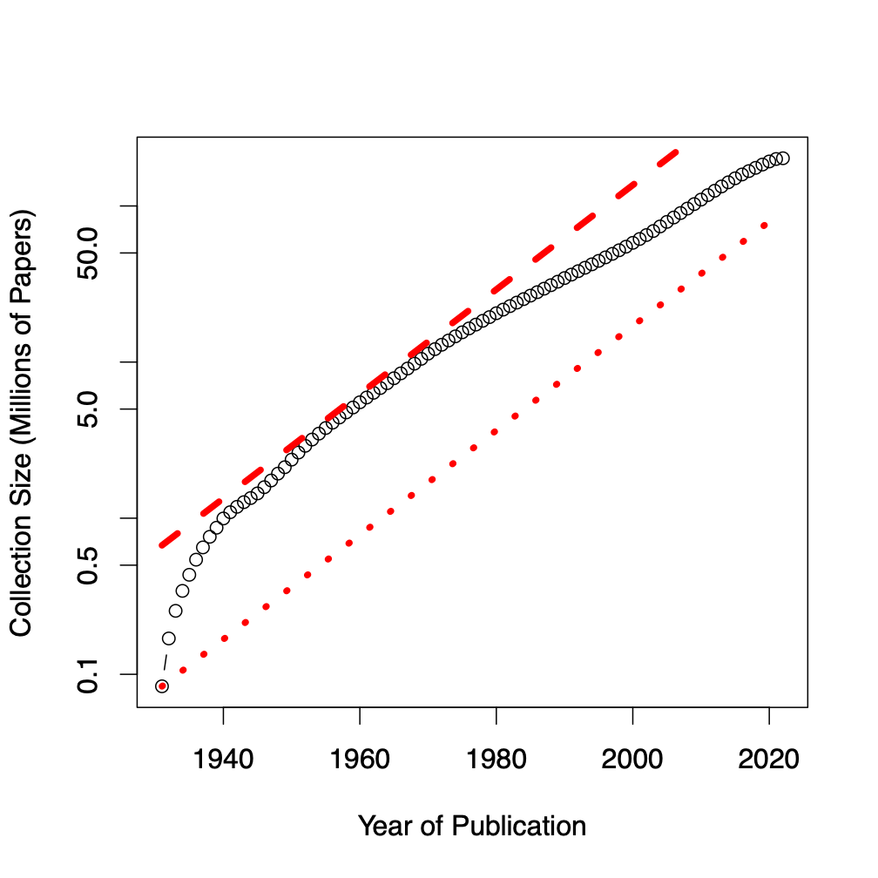
Assign 200M papers to 100 bins (by time)
Sort 200M papers by publication date
Output: Split papers into 100 bins, with 2M papers/bin
Because of exponential growth
(literature doubles every 9 years)
older bins span more time, and
newer bins span less time
Bin 99
………
Bin 0
Time
90% of literature published after I went to grad school
Notes:
mention equal # papers
consider replacing w/ diagram

Slide 28
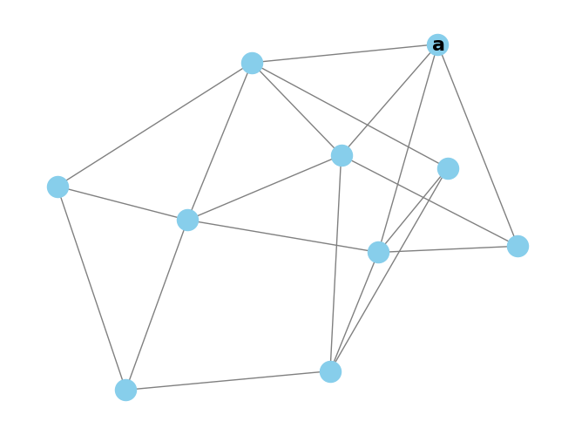
Intrinsic Evaluation - Random Walk Classification
Randomly pick start paper a

Slide 29
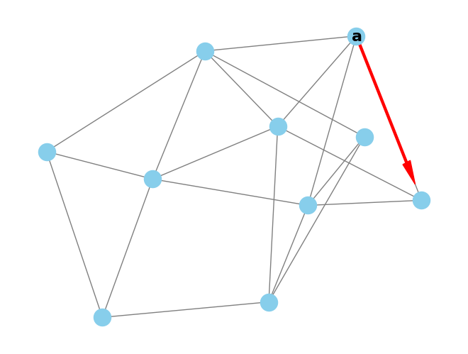
Intrinsic Evaluation - Random Walk Classification
Randomly pick start paper a
Jump to any referenced or citing paper

Slide 30
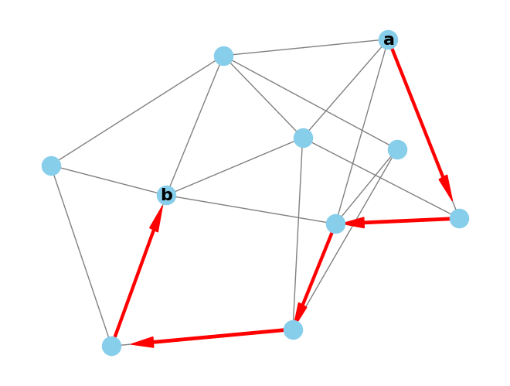
Intrinsic Evaluation - Random Walk Classification
Randomly pick start paper a
Jump to any referenced or citing paper
Repeat to reach final paper b

Slide 31
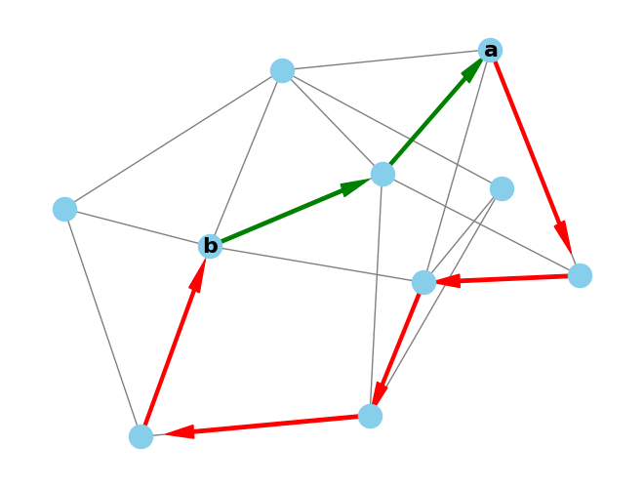
Intrinsic Evaluation - Random Walk Classification
Randomly pick start paper a
Jump to any referenced or citing paper
Repeat to reach final paper b
Verify the shortest path between a and b is in [1,4]
= 2-hop

Slide 32
Intrinsic Evaluation - Random Walk Classification
Randomly pick start paper a
Jump to any referenced or citing paper
Repeat to reach final paper b
Verify the shortest path between a and b is in [1,4]
It’s cheap to collect these of random walks, we have 3M
Hypothesis: representation models should have higher similarity for 1 hop than 2-4 hops.

Slide 33
Intrinsic Evaluation - Random Walk Forecasting
Can assign walks to bins for forecast evaluation
Walk bin = max(bin(a), bin(b))
Given the ProNE trained models, how well can they:
Remember from train (bin<=train split)
Predict the future (bin>train split)
Does this get harder as bin >> train split?

Slide 34
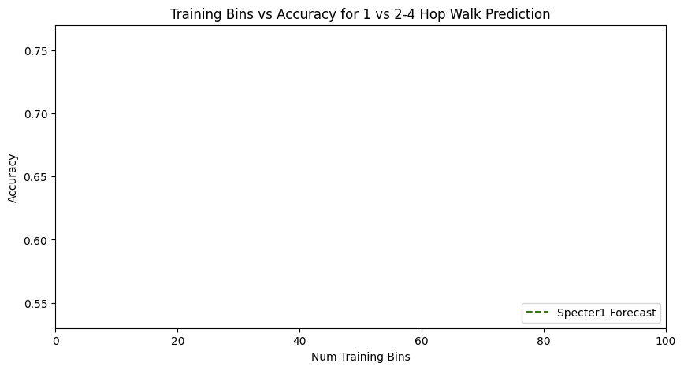
Forecasting with Text

Slide 35
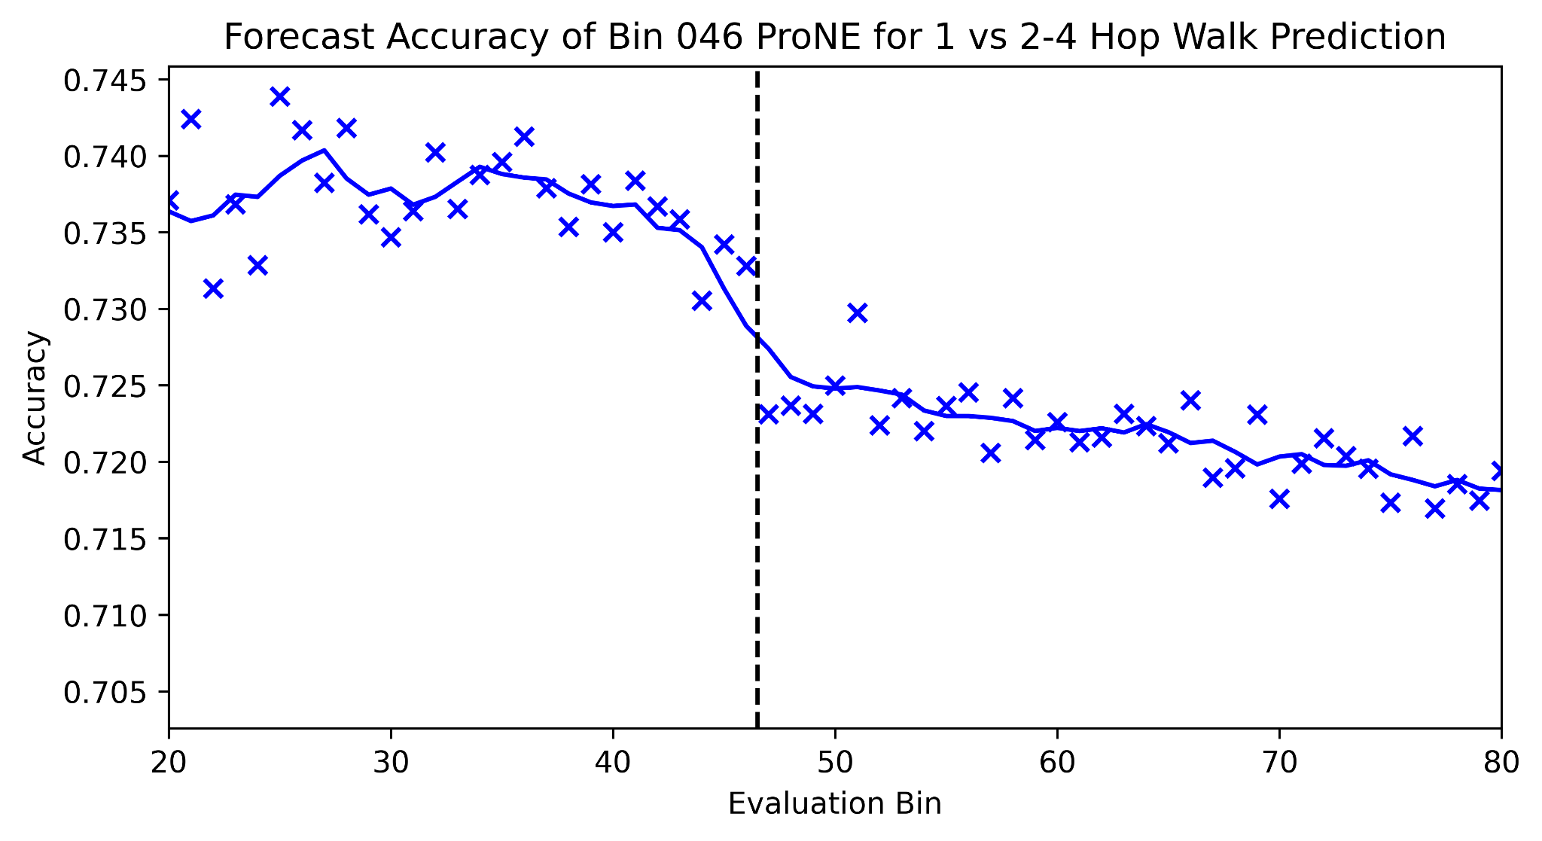
Forecasting from Bin 46

Slide 36
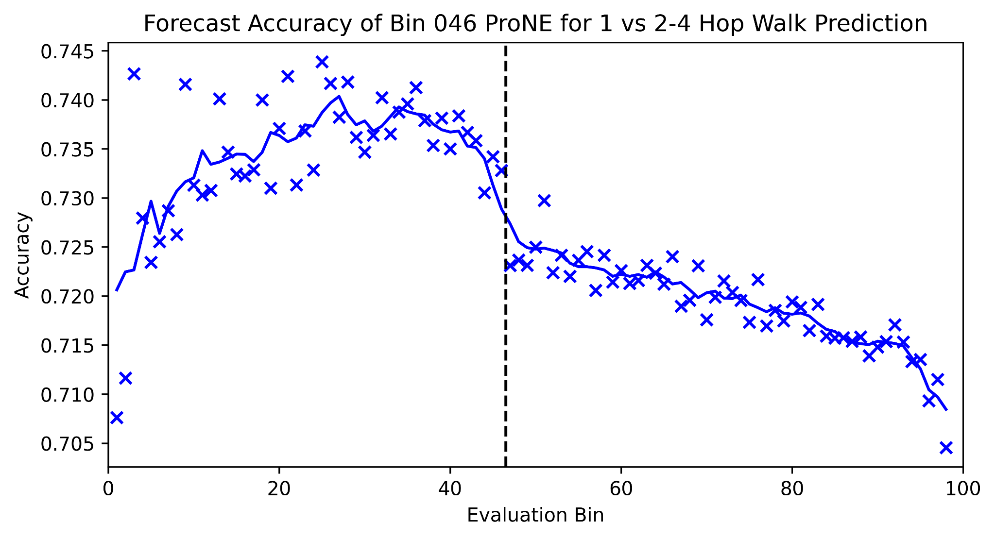
Forecasting from Bin 46 - Full Picture

Slide 37
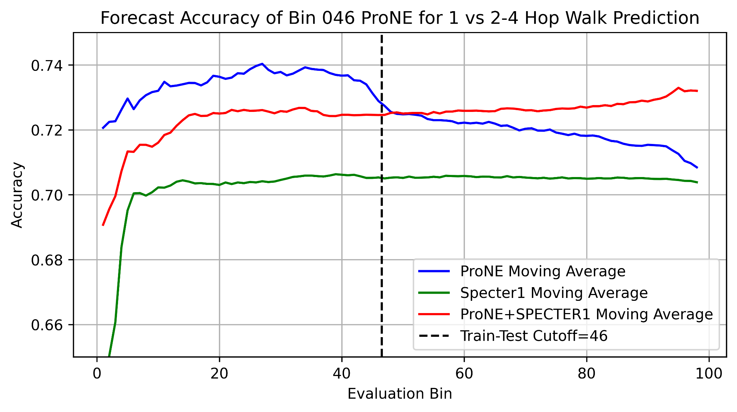
Better Together Observations
ProNE (Context) >> Specter (Text)
Ensembles are better
than either by itself
Text is most helpful
when links are not working well
i.e., long-term forecasting

Slide 38
Conclusion: Deliverables https://kwchurch.github.io/
GitHub:
massive (but needs editing)
slides, code, reading list
pointers to large files on Globus
Web Server
Recommendations
Input: queries (docs)
Output: recommendations (docs)
What Should I read? Cite?
Resources
Data behind web server:
citation graph
embeddings
indexes for approx. nearest neighbors
pairs of corpusIds with large cosines
all of the above for
Specter1, Specter2, SciNCL, ProNE
x100 bins for ProNE
Evaluations & Benchmarks
Intrinsic: Perplexity, Random Walks
Extrinsic: Local Citation Prediction

